Slide 1

ASB Project in Azure DevOps

Slide 2


Key differences
Read about the key differences in the new ASB ADO project you’re migrating to:
One ADO Project for all ASB work
Simplification of work item types
Simplification of work item states

Slide 3
Summary of ASB ADO one project
All ASB work will be contained within one project in ADO
Different divisions (Tribes, Platforms, Programs, Projects) will be separated via area paths
Area paths will be open by default to enable greater sharing of information
User stories belonging to one epic can be shared across squads and tribes etc

Slide 4
ASB ADO one project - benefits
Centralisation and management of backlogs in one location- ADO cloud.
Enable sharing of work across multiple squads/Tribes etc
Better reporting/ enable dashboards and queries to display data from across the organisation
Better ability to track milestones
Increased visibility and transparency - open by default

Slide 5

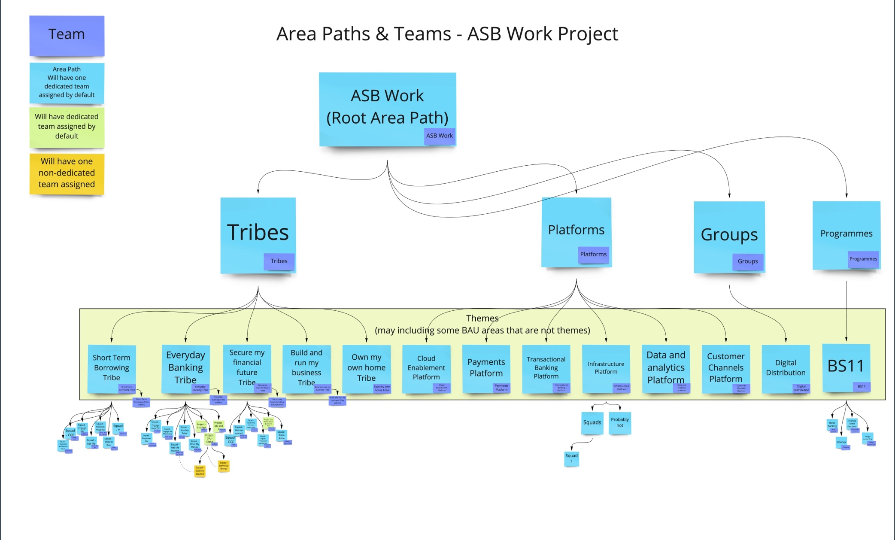
One ASB ADO project, future state
All levels are created via area paths in ADO
Area paths are akin to a windows file structure
Admins can add areas
Notes:
Designed to help you:
Plan work
Focus on what your priorities are
Track your work in progress
Manage your backlog
Discuss work with your stakeholders
Work across multiple teams
I have used it to:
Keep on top of a simple todo list using a Kanban board for my BAU (business as usual) work
Run software delivery projects using sprints
Manage backlogs and work with stakeholders to prioritise work
Track a waterfall project – albeit in a agile flavour. Delivered as a waterfall project, worked as an agile project.

Slide 6
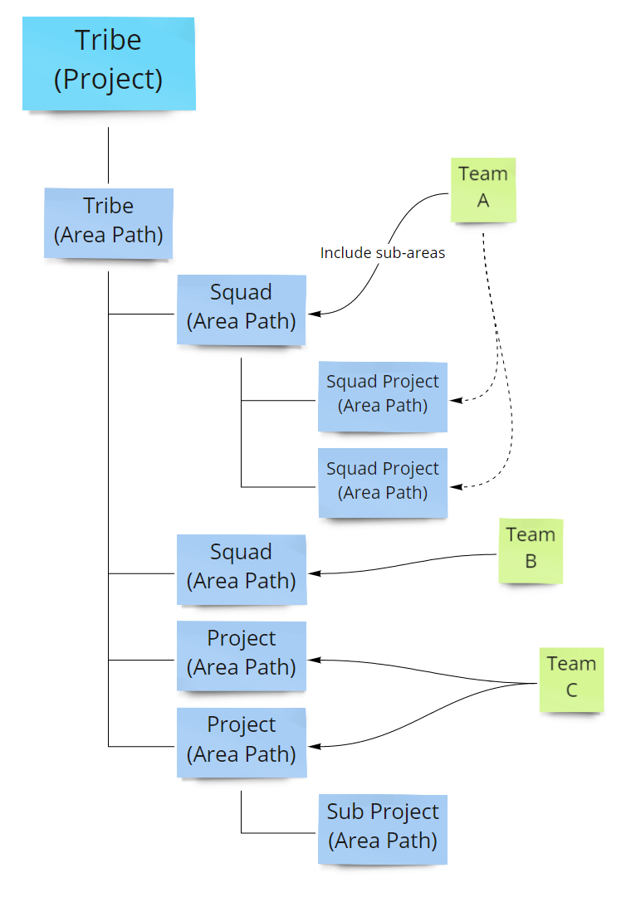
Using area paths to group work
ASB Project
Tribes, Platforms and Programs all sit under the ASB project
Squads or Projects sit under the divisions above
Multiple levels of area path can be created -area Paths allow squads flexibility to group work into ‘buckets’
A Tribe/Platform could have an Area Path for:
Approved work
Or incoming work
Or de-prioritised work
Squads control their Area Path structure.
Mastering Area Paths is key to mastering Azure DevOps.

Slide 7
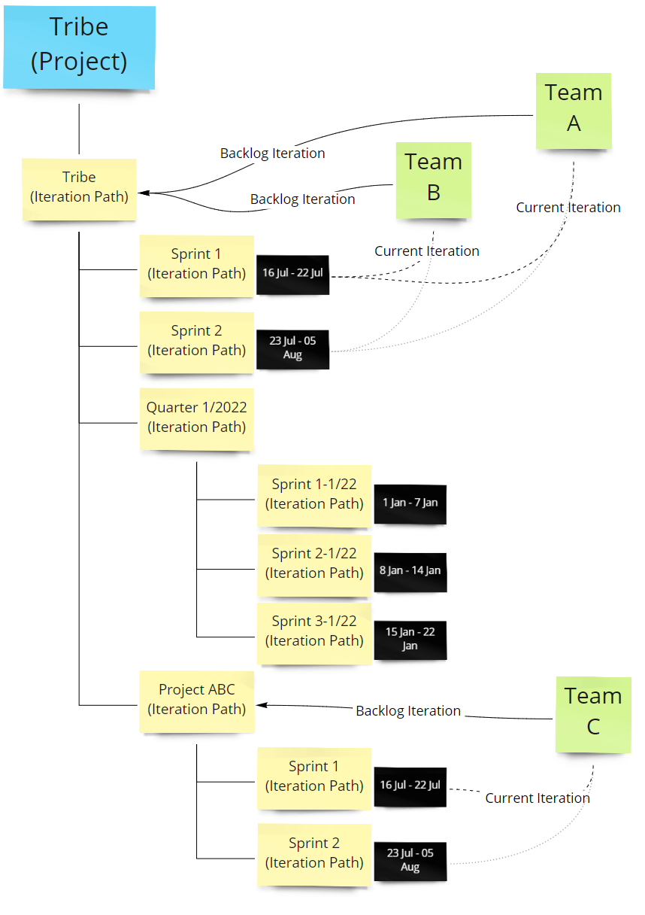
Using iteration Paths
ASB Project
Iteration paths allow you to group work items into:
Sprints
Milestones
Other event-specific or time boxed activities
How are area and iteration paths used? - Azure DevOps | Microsoft Docs
Notes:
Work items are also sorted into Iteration paths
Iteration paths are structure much like area paths, however they are used to a place work items in blocks of time
A team has a backlog iteration
Used to store work which is not yet scheduled
Your backlog iteration will have sub iterations
These iterations are normally your sprints
Teams can share the same iterations. Backlog and sub iterations.
Generally, best practice is to use the tribe iteration path as the backlog iteration for teams, and then to have a flat structure of sprints under that tribe iteration path
Sometimes iterations get organised into Quarters with sprints as sub iterations.
This is used to report easier on work done in a quarter.

Slide 8
Summary of simplification of process and work items
All teams will use the Agile process in the ASB ADO project
Disabled work item types are removed from the work item list
Use of User story rather than Product Backlog Item
Simplification of work item states

Slide 9
Simplification of process and work items, benefits
Aligned to the ASB Delivery Framework
Simplification and alignment of processes, everyone using the same process (Agile template)
Consistent language

Slide 10
Simplification of work items
ASB ADO work item types V2 | ASB ADO current work item types
Assumption Bug Decision Dependency Epic Feature OKR Issue Risk Task Test case Test plan Test suite User story | Assumption Assurance (disabled) Bug Decision Dependency Enhancement (disabled) Epic Feature Impediment (disabled) Product backlog item (disabled) Issue Risk Task Test case Test plan Test suite Tribe epic (disabled) User story
All teams will use the ADO Agile template as it offers greater flexibility than the Scrum template
For those previously on the Scrum template, please note that you will use User Story instead of Product Backlog Item
We’ve removed disabled work item types from the work item list to make it less confusing (shown in grey on the table)

Slide 11
Fields on work items
Tribes/squads etc will no longer be able to add custom fields to work items as everyone will see the same work items and their fields
If you have a requirement to query by a unique field type we can enable this via the metadata tab on work items (see next page)
However they can still devise and add templates to ADO for use by their squads.

Slide 12
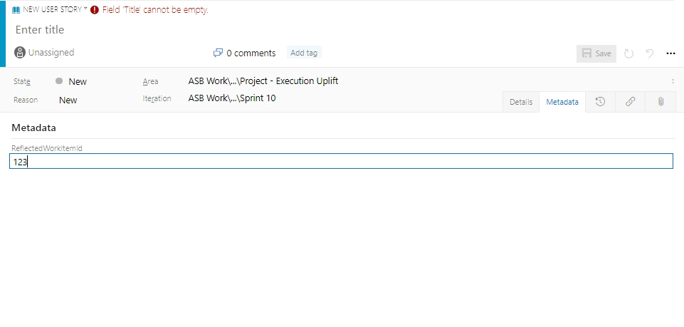
Metadata page
Custom fields can be added to the metadata page if required.
.

Slide 13
Simplification of User story states, benefits
States are generic and can be used for a number of different requirements
Enables clean data, which allows for better reporting
Full support of out of the box functionality
Leveraging the usability testing Microsoft has completed with the out of the box design

Slide 14
Simplification of User story states
Committed has been removed, it’s recommended that work is assigned to sprints to identify committed work, rather than using a state
Out of the box states are used, with the addition of Approved:
New
Approved
Active
Resolved
Closed
Removed
ASB ADO work item states V2 | ASB ADO current work item states
New Approved Active Resolved Closed Removed | New Blocked Committed Active Resolved Done Removed

Slide 15
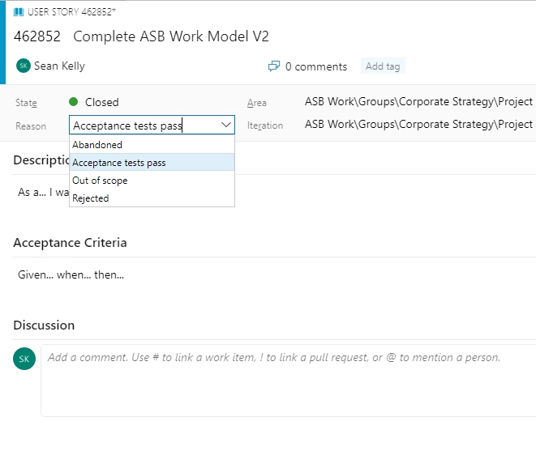
Done state removal
There are a number of reasons why an item is closed that don’t necessarily mean it has been completed/done, therefore Done has been removed
The out of box states Resolved and Closed are used instead
Use resolved when you have finished working on an item but would like acceptance or confirmation from your squad or CXO
.

Slide 16
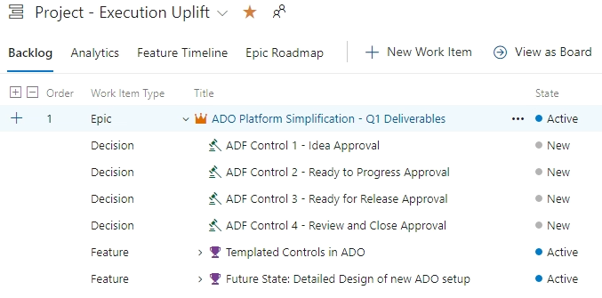
Greater alignment with ADF (controls)
Prioritised the addition of RAID items to Epic by adding to options in ‘+’ beside epic,
Users can still add RAID items via add related item on stories and features (and epics).

Slide 17
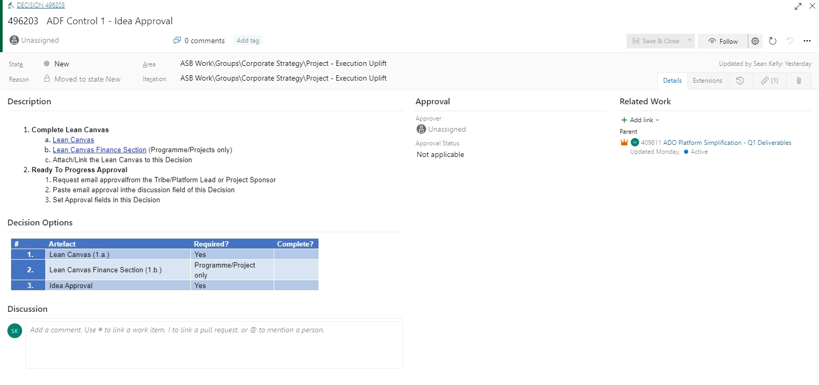
ASB Delivery Framework Templates
On the decision work item type, select elipsis (...) and select desired template
Available templates include:
ADF Control 1 – Idea Approval
ADF Control 2 – Ready to progress approval
ADF Control 3 – Ready for release approval
ADF Control 4 – Review and Close approval

Slide 18
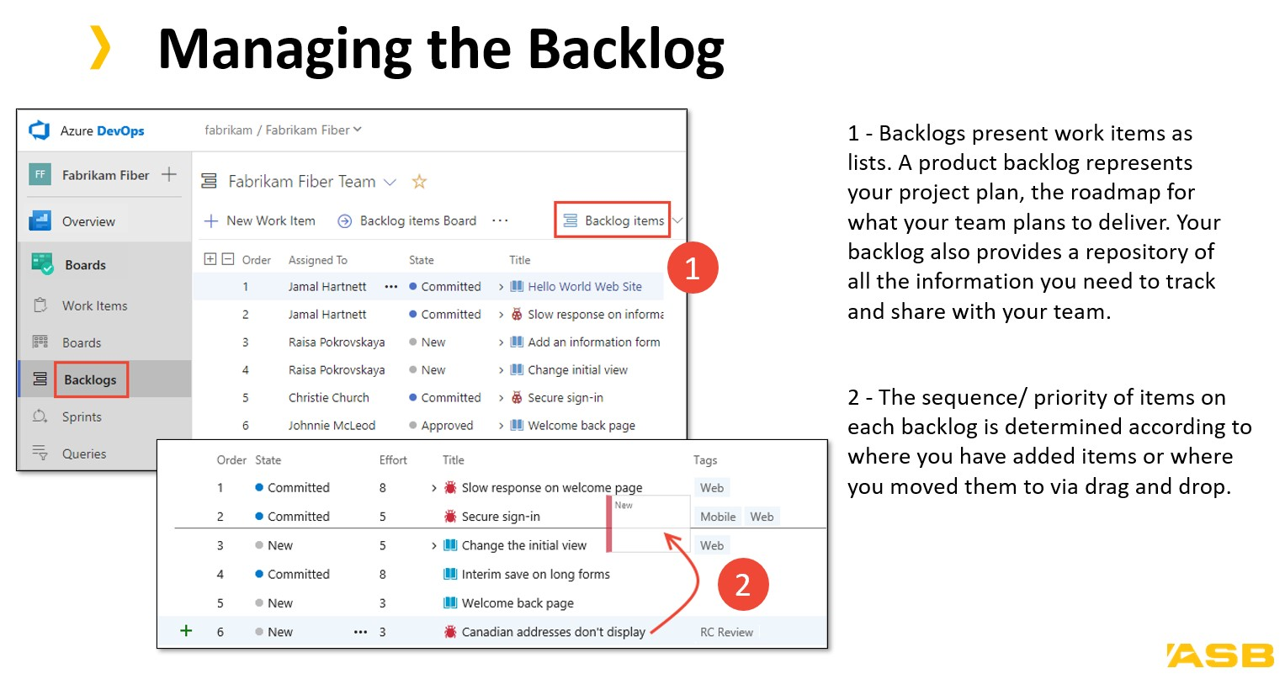
Getting help with ADO
Crowd source your answer from the Teams channel: ‘Azure DevOps (ADO) community’
Find user guides: http://webappspinsite.asbbank.co.nz/About-ASB/How%20we%20work/delivery/deliveryframework/Pages/default.aspx
Feedback and questions on migration can be directed to: AzureDevOpsMigrationProject@asb.co.nz

Slide 19
Send your feedback to: AzureDevOpsMigrationProject@asb.co.nz

